Slide 1
Water Quality Prediction using Machine Learning
Sarthak Kapaliya (20BCP072) Div-1
Kaxit Pandya (20BCP063) G2 batch
Dhruvil Patel (20BCP067)

Slide 2
Abstract
Water quality index (WQI) is valuable and unique rating to depict the overall water quality status in a single term that is helpful for the selection of appropriate treatment technique to meet the concerned issues.
An attempt has been made to develop water quality index (WQI), using several water quality parameters like pH, dissolved oxygen, biochemical oxygen demand, electrical conductivity, nitrate nitrogen and temperature.
The dataset used here is real-time data taken from Central Pollution Control Board(CPCB). The available dataset contains latest water quality parameters of Rivers in India collected in recent years.
When it comes to estimate water quality, We use classical machine learning algorithms for instance Support Vector Machines (SVM), Neural Networks (NN), k-Nearest Neighbors (k-NN), Random Forest Regressor.

Slide 3
Introduction
About 75% of the world’s surface area is covered with water. Out of which 97% of the earth’s water is in the ocean, not fit for human use due to its high salt content. Remaining 2% is locked in polar ice caps and only 1% is available as fresh water in rivers, lakes, streams reservoirs and ground water, suitable for human consumption.
In developing countries, 80% of the diseases are water borne diseases, which have led to 5 million deaths and 2.5 billion illnesses.
WQI is an a superior way to the understanding of water quality issues by integrating complex data and generating a score, which ultimately describes the water quality status.
The main objective of this study is to obtain the required information or trends in water quality to design specific water pollution prevention programs.
This model can help in prescriptive analysis using the expected values that will lead to better decision-making for future facilities such as Water treatment plants.

Slide 4
Literature Survey
Clean and safe freshwater is of utmost importance to the survival of all living components in the ecosystem. Water quality issues are complex and diverse, deserving urgent global attention and action.
Local water quality can be used to identify the sources and fates of toxic contaminants and pollutants either from ecology, geology, and (industrial processes, runoff from agricultural farms etc) in the area Identifying the source (s) of contamination and developing appropriate management strategies are essential to minimizing potential public health risks.
Water quality index is a standard mechanism that helps to reduce water quality data to common scale divided as poor , moderate and excellent.
It will hopefully result in curtailment of people consuming poor quality water and consequently de-escalate harrowing diseases like typhoid and diarrhea.

Slide 5
Merits of using water quality index(wqi) –
1.Reduction in the number of parameters required to compare water quality for a definite use.
2.Provision of a single number that represents overall water quality at a certain location and time.
3.Identification of space and time dynamics in the quality of water.
Mostly for predicting water quality, Regression and Classification models are used.

Slide 6
Related Work
In 2019, Umair et. Al proposed a water quality prediction model using classification algorithms(Multi Layer Perceptron, Decision Tree, etc) getting at most 85% accuracy and regression algorithms are having least error.
In 2012, Gazzaz et al. used ANN to predict the WQI with a model explaining almost 99.5% of variation in the data. They used 23 parameters to predict the WQI, which turns out to be quite expensive if one is to use it for an IoT system, given the prices of the sensors.
In 2014,Vinod Bhave proposed water quality index for assessment of surface water quality status in Goa.The water quality analysis shows that the 47.22 % surface water samples were found as Good category and 47.22 % moderate category can be use for direct consumption while 5.56 % belongs to poor category shows that the water is not suitable for direct consumption.
In 2016, Sakizadeh predicted the WQI using 16 water quality parameters and ANN with Bayesian regularization. His study yielded correlation coefficients between the observed and predicted values of 0.94 and 0.77, respectively.

Slide 7
Dataset Description
Water Quality database from Central Pollution Control Board(CPCB)
1. Water Quality of Rivers -2021.
2. Water Quality of Rivers -2020.
3. Water Quality of Ground Water 2021 (State wise).
4. Water Quality of Ground Water 2020 (State wise).
Kaggle dataset
1. Water quality dataset(related to potability & turbidity).
2. Indian water quality dataset(Historical state wise).

Slide 8
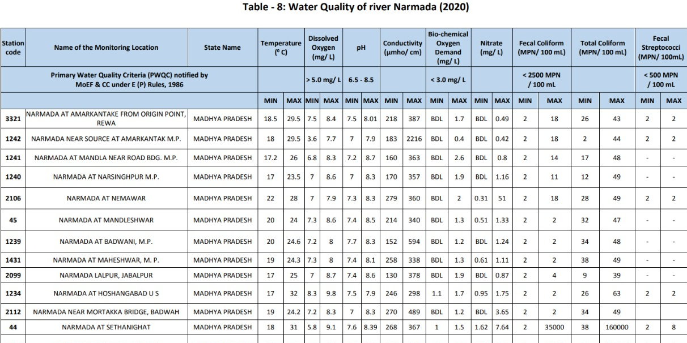

Slide 9
Proposed Work
To implement Machine Learning Method/Algorithm:
1. We conduct Data Processing steps(Data Exploration ,Outlier Detection and Normalization) Here we check for missing values or outliers in the dataset and normalize the data.
2. Feature Selection and Cross Validation : We choose appropriate features which help to increase model performance. We implement cross validation steps also.
3. Model Selection: The water quality dataset contain different parameters from which we can have both Regression (Multi linear regression, polynomial Regression) and Classification(Support Vector Machine, Random Forest) methods for training a model. We apply the model for calculating accurate Water Quality Index.
4. Evaluation: We evaluate the model using performance metrics of regression (MAE, RMSE ,etc.) and classification(Accuracy ,Recall ,Precision)
5. After the model is trained and evaluated, We can use it for various purpose like making an application to check quality of water based on user’s input and deploy it.

Slide 10
Conclusion
The aim of this study is to assess the quality of river and groundwater for the suitability of drinking and domestic purpose.
This study will be helpful for public to understand the quality of water as well as to understand WQI which is a useful tool in many ways in the field of water quality management.
Future work will include applying both Classification and Regression algorithms on the dataset, we will conclude that which model will give highest accuracy to estimate WQI.
Accuracy could be increased by training more fresh dataset of current year from CPCB database and by reducing error rate.

Slide 11
Thank You Any Questions ?

